Slide 1



Celia, Mounika, Sharon
Stroke Prediction

Slide 2
According to the CDC:
Every year more than 795,000 people in the US have a stroke.
Every 40 seconds someone in the US has a stroke.
Every 4 minutes someone dies of a stroke.
Stroke related costs in the US were nearly $46 billion between 2014 and 2015.
Stroke is a leading cause of long term disability

Slide 3
What if we could analyze and train a model to identify potential stroke victims
before they happen? Using a dataset of patient information featuring
5110 patients, we constructed models to predict occurrence of stroke.

Slide 4
Dataset Features
Id
Gender
Age
Hypertension
Heart Disease
Marital Status
Profession Type
Residence Type
Average Glucose Level
BMI
Smoking Status
Stroke

Slide 5
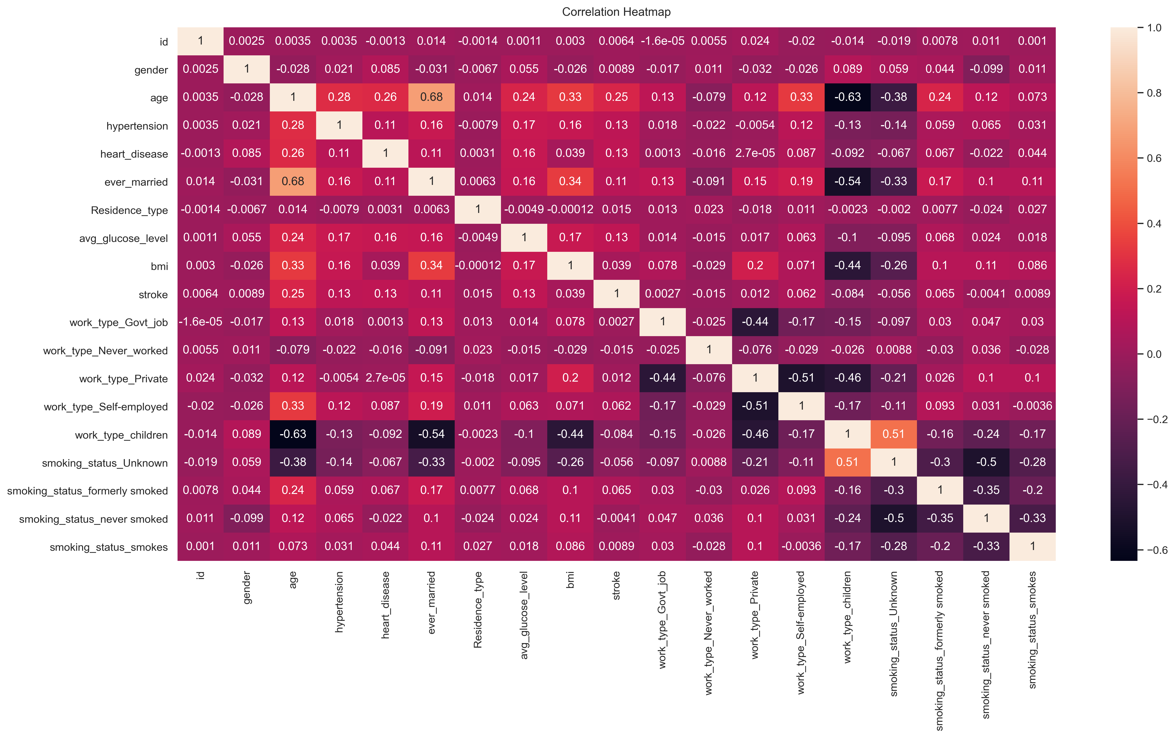

Slide 6
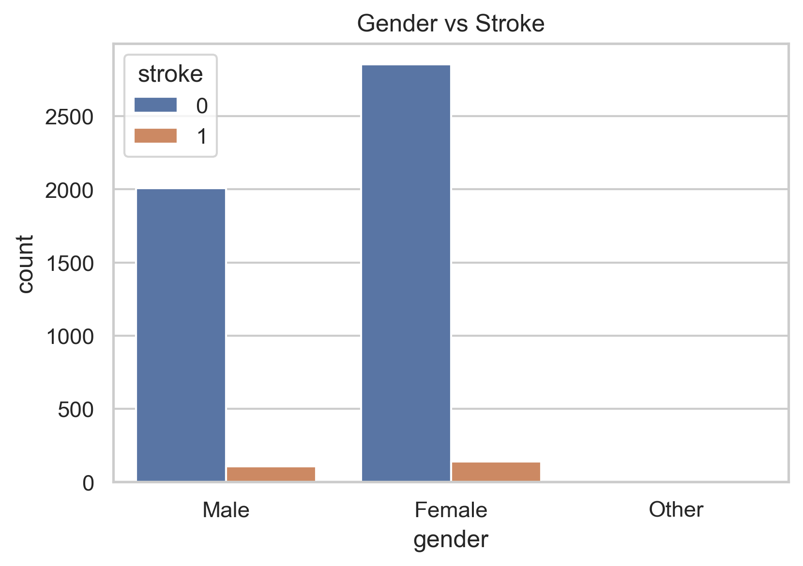

Slide 7
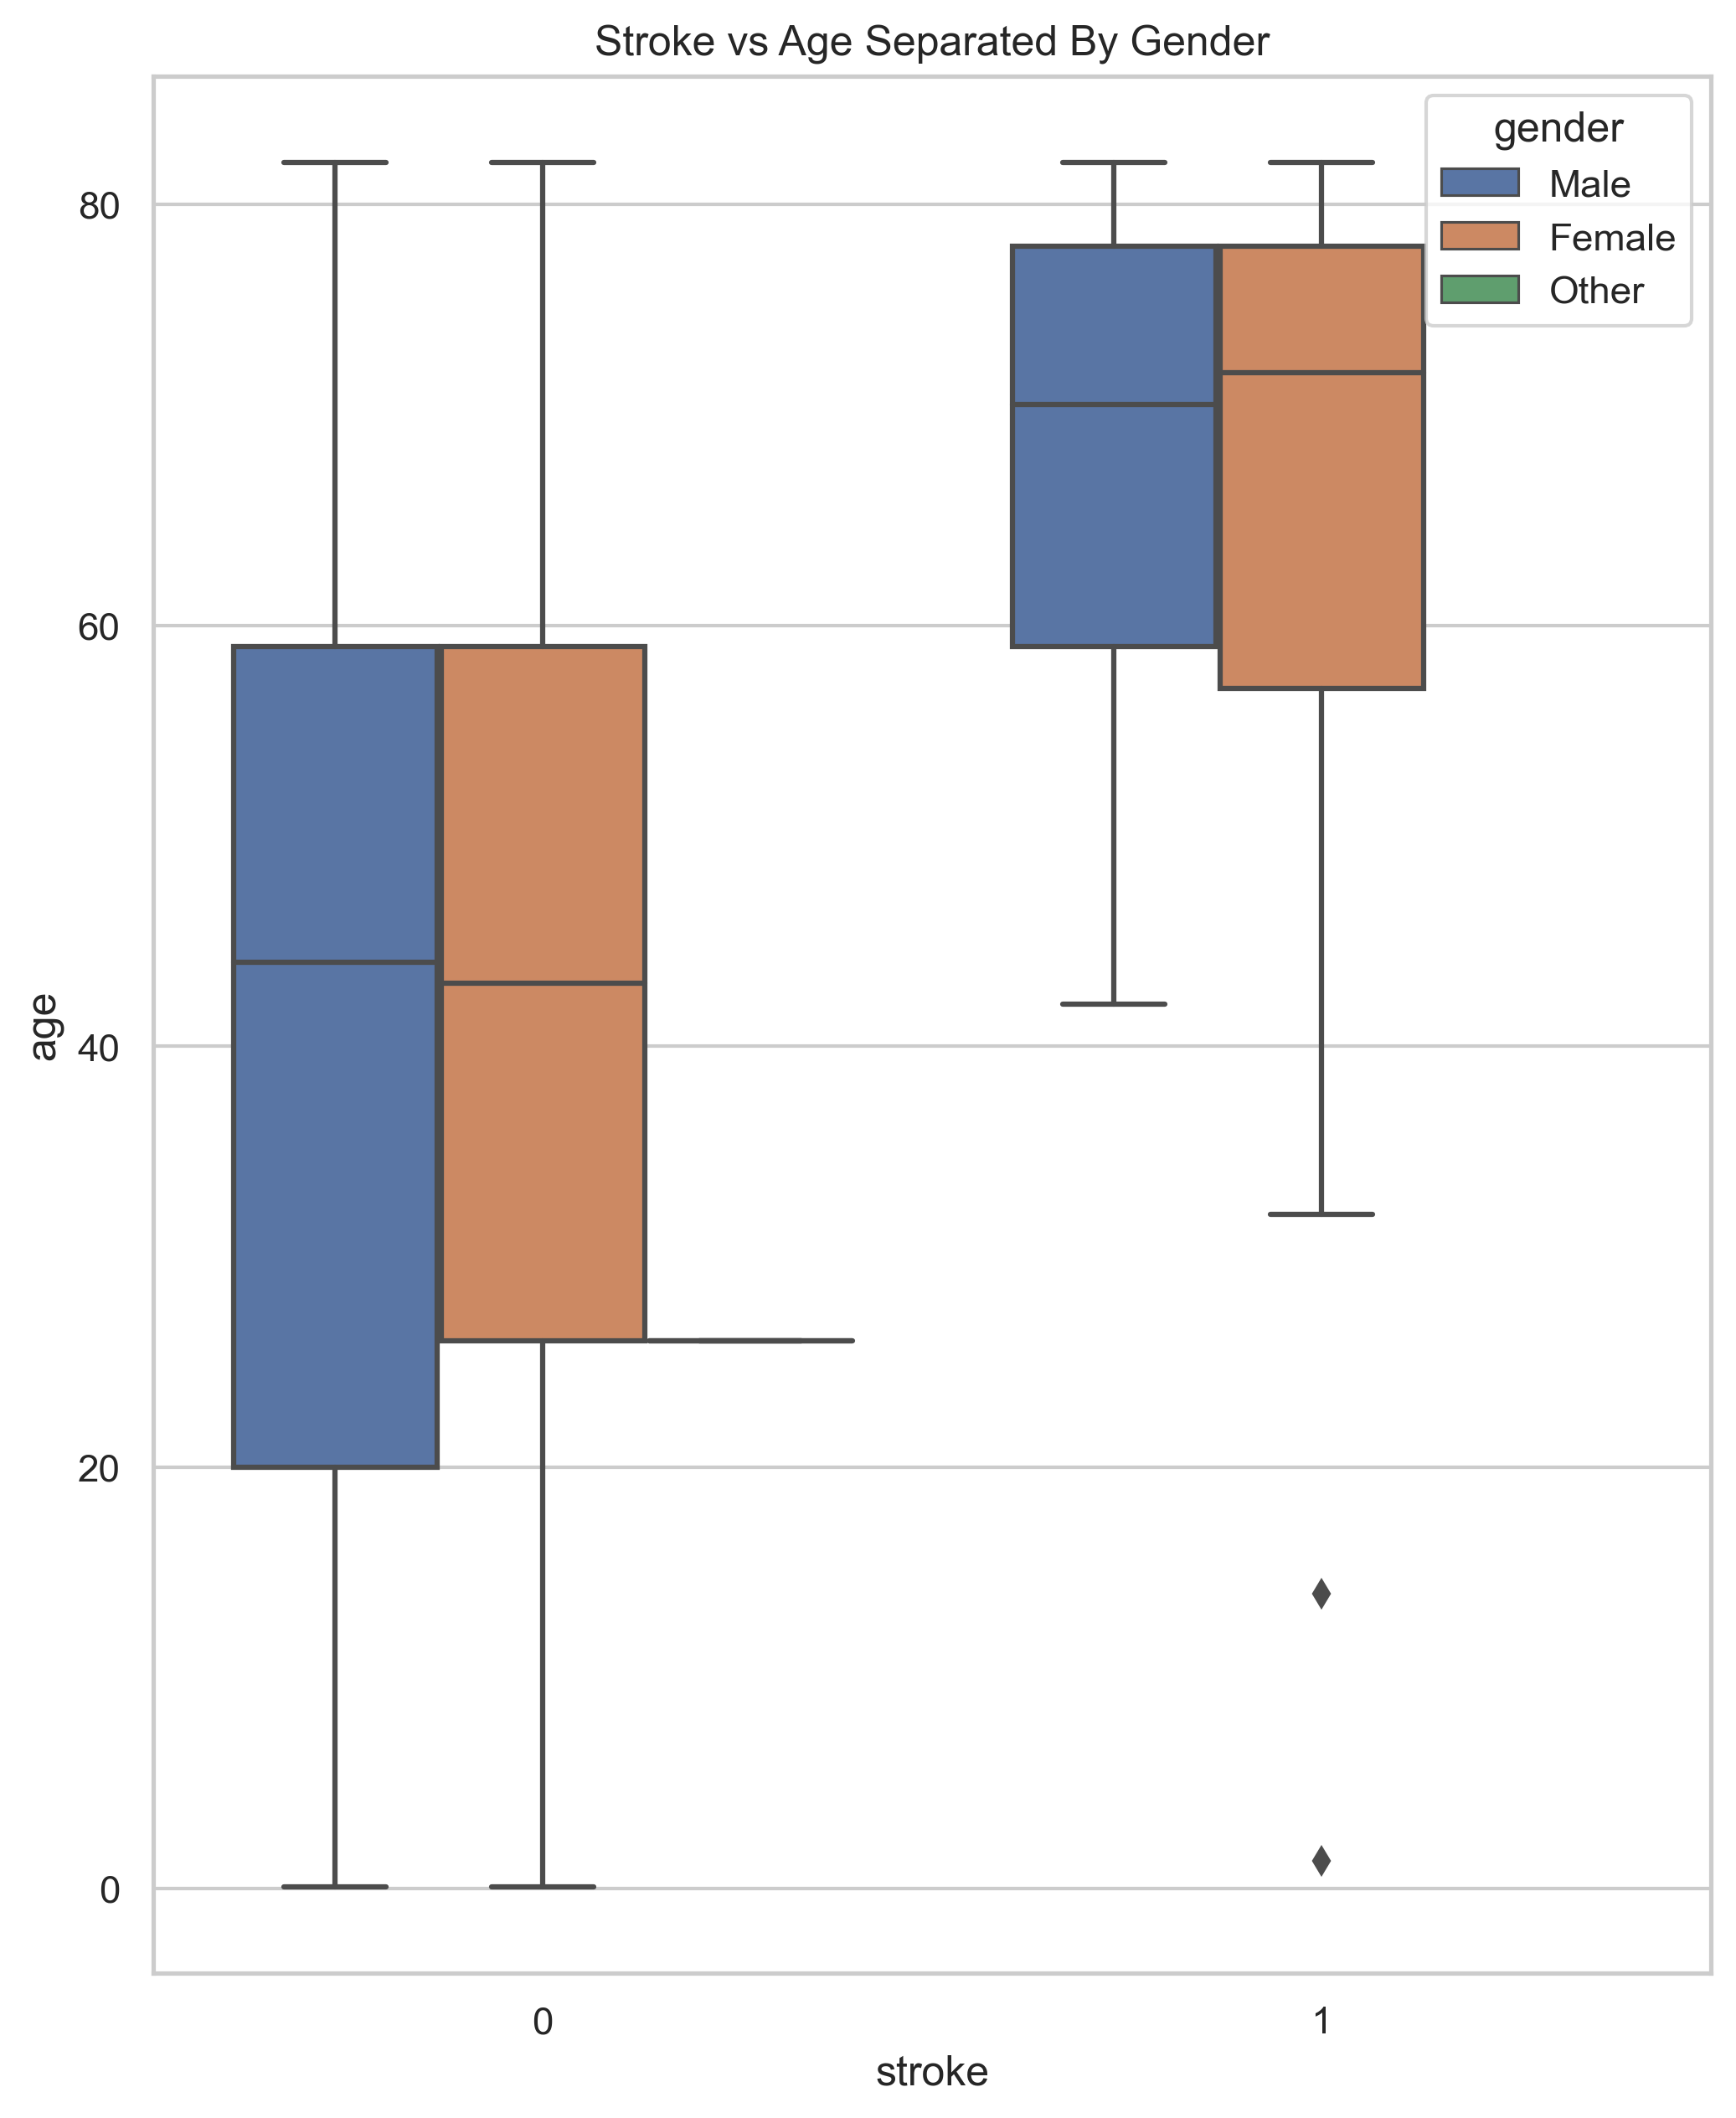

Slide 8
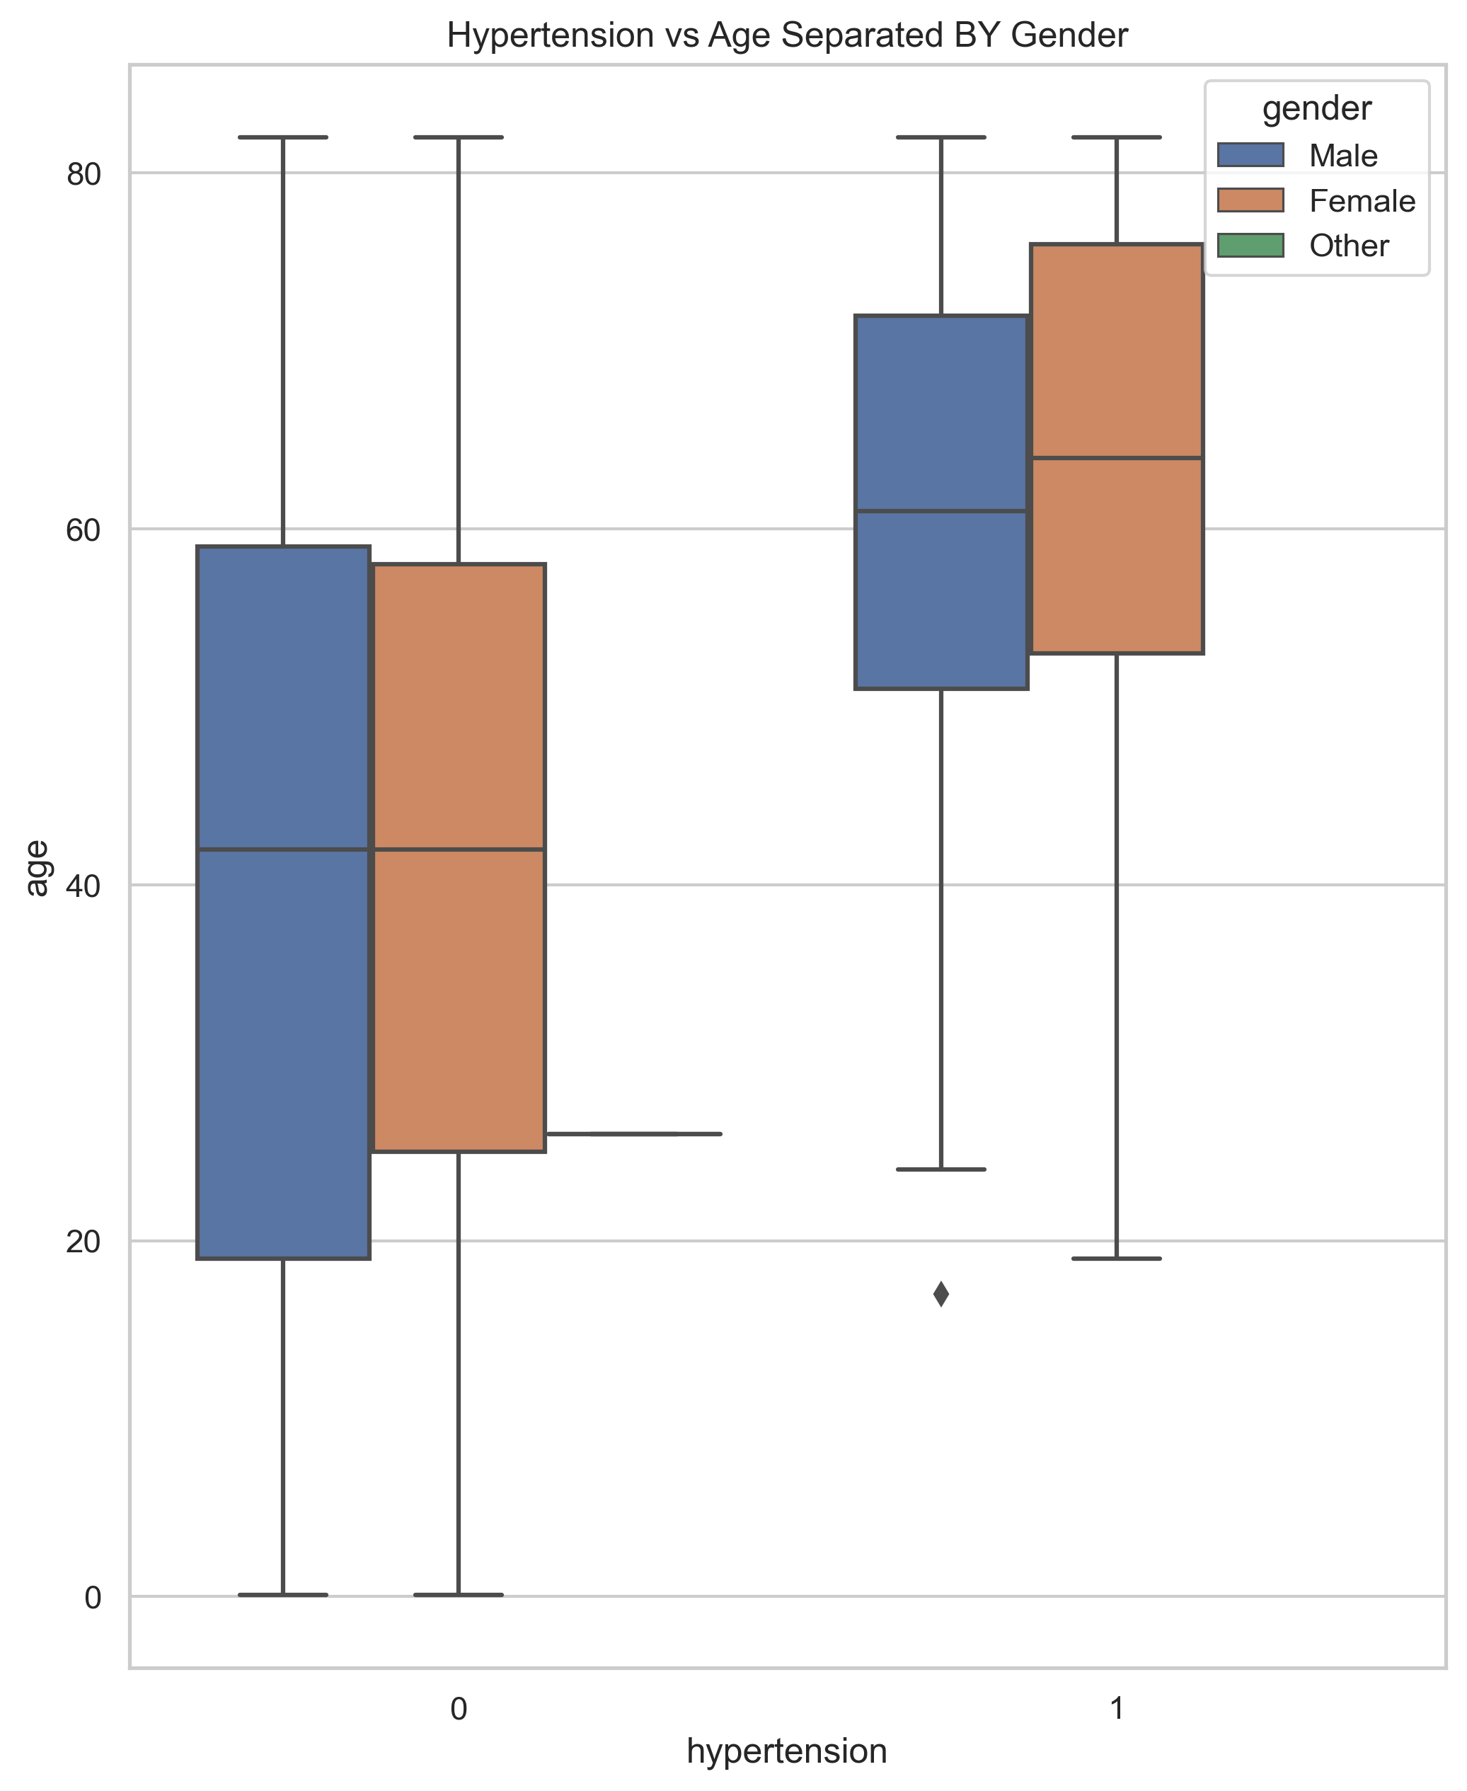

Slide 9
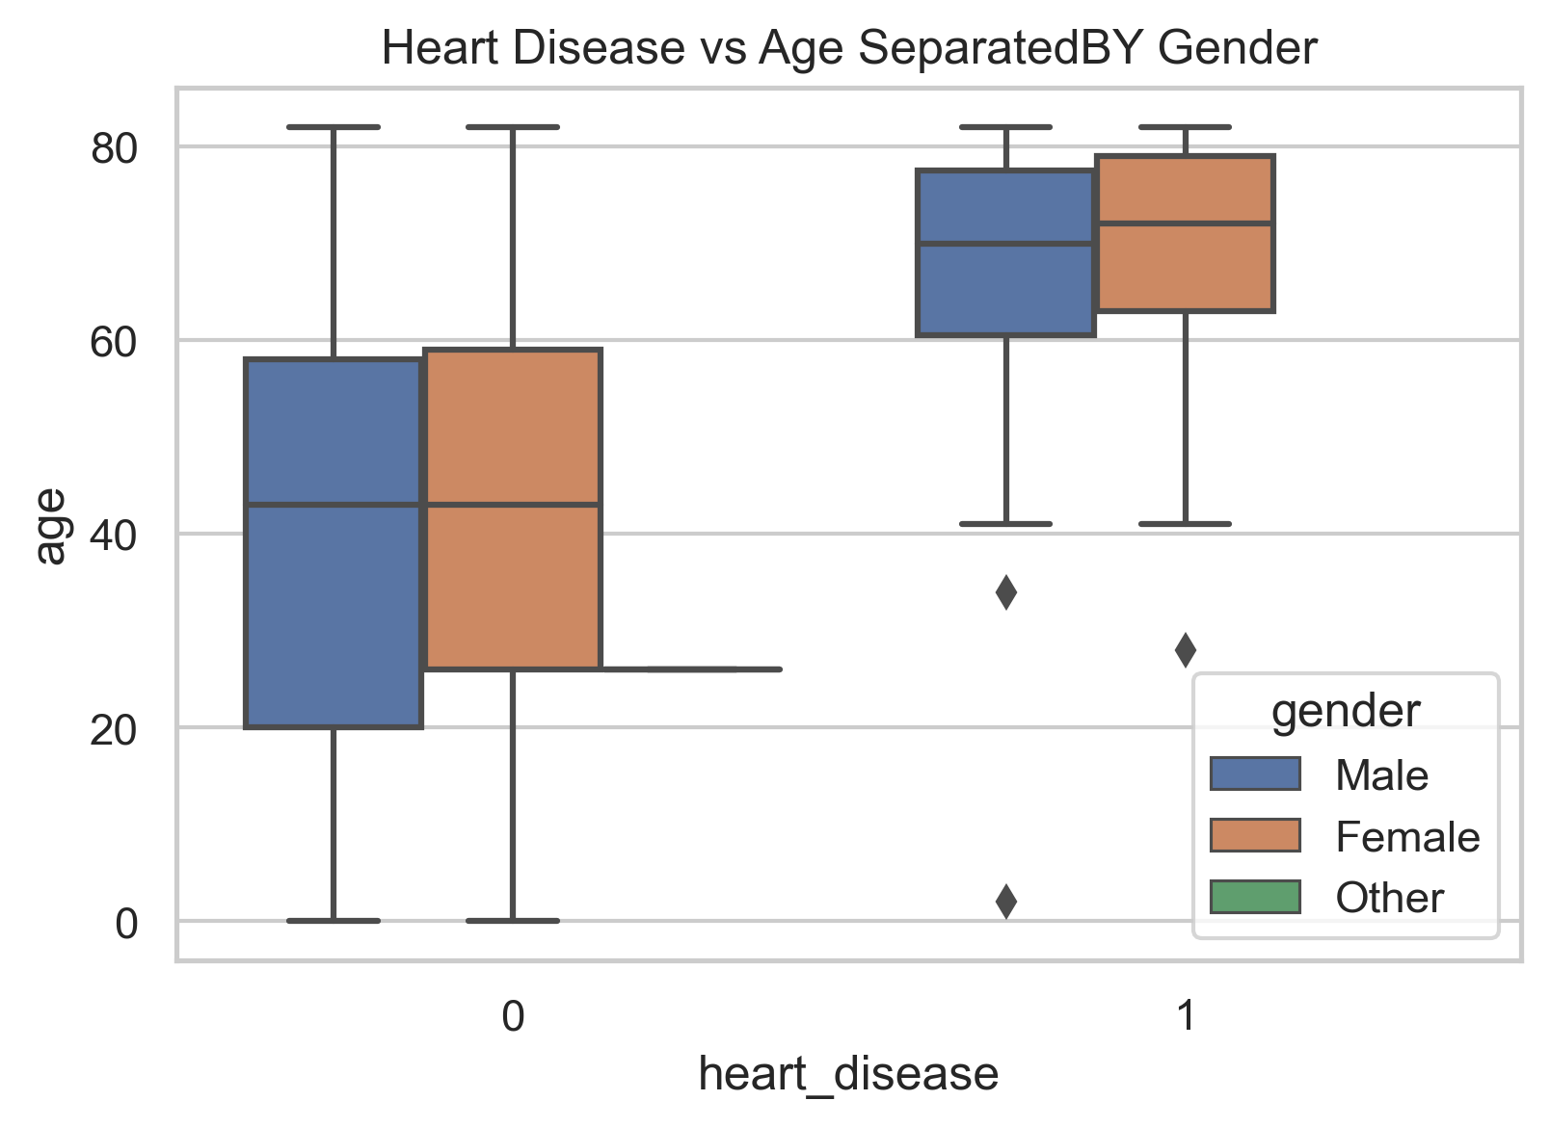

Slide 10
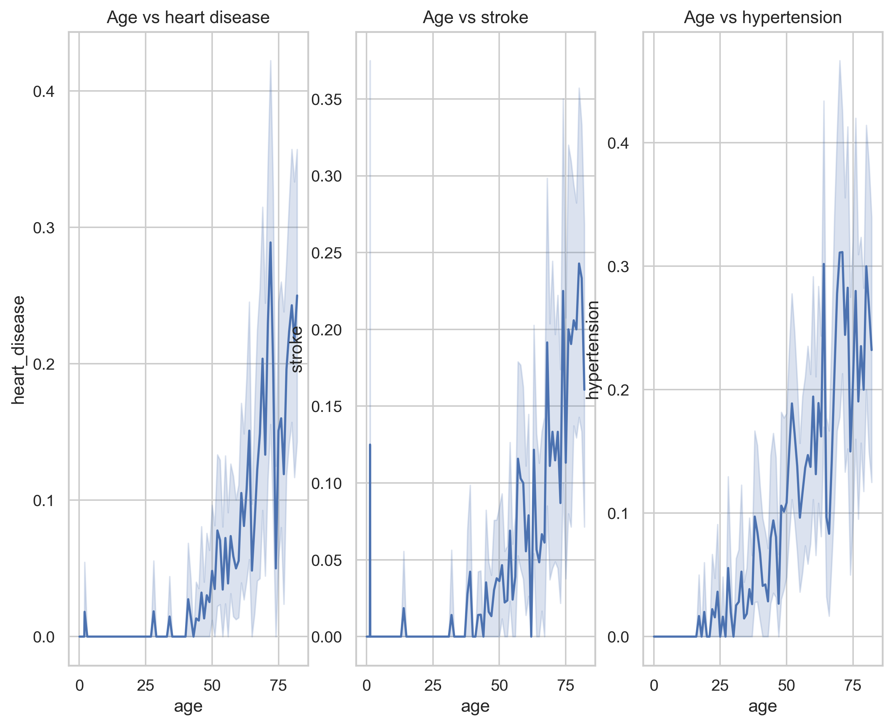

Slide 11
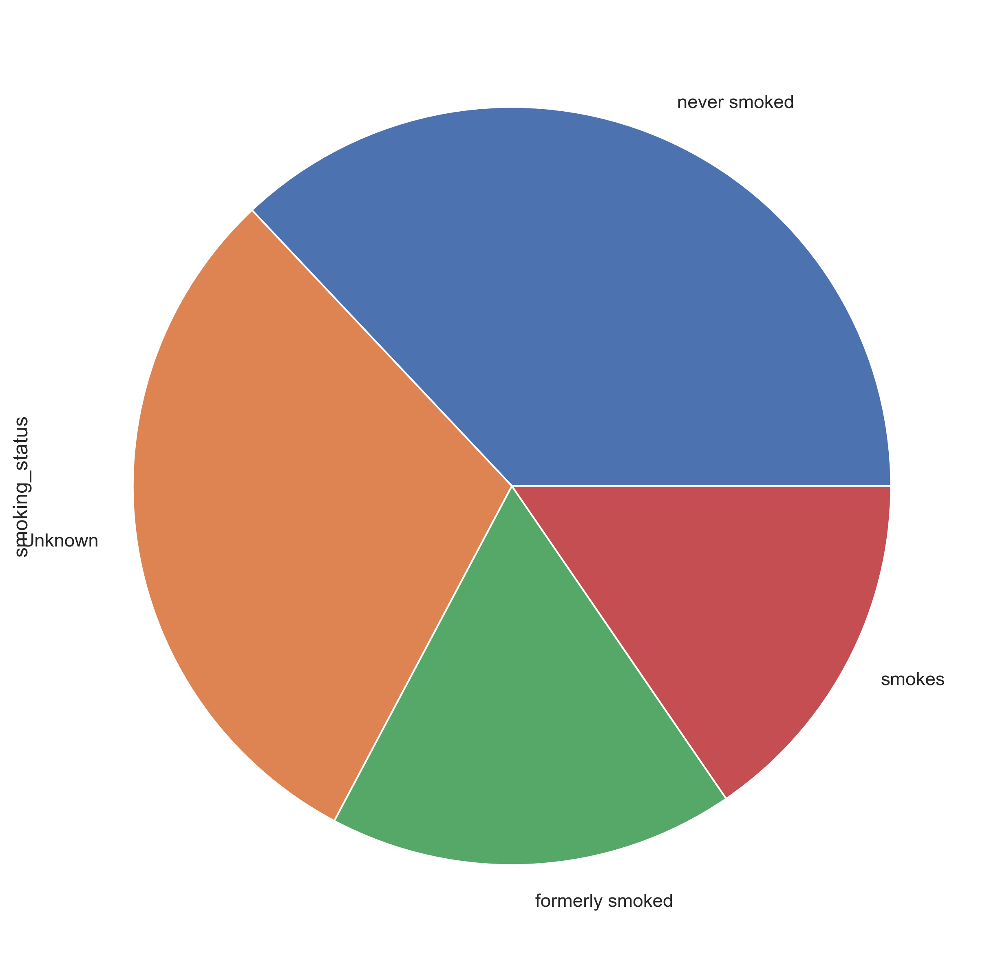
Smoking Status

Slide 12
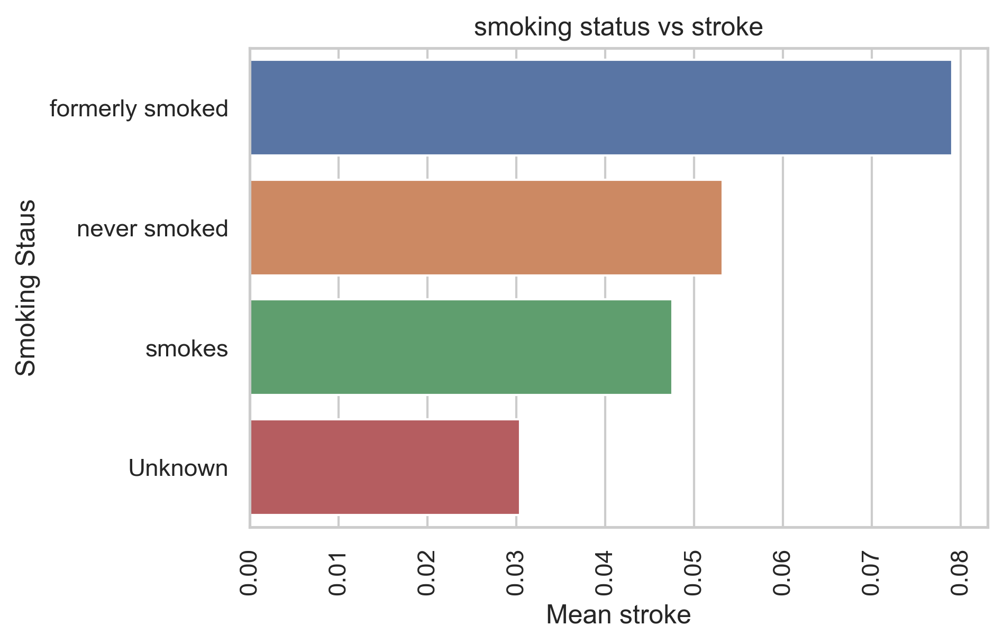

Slide 13
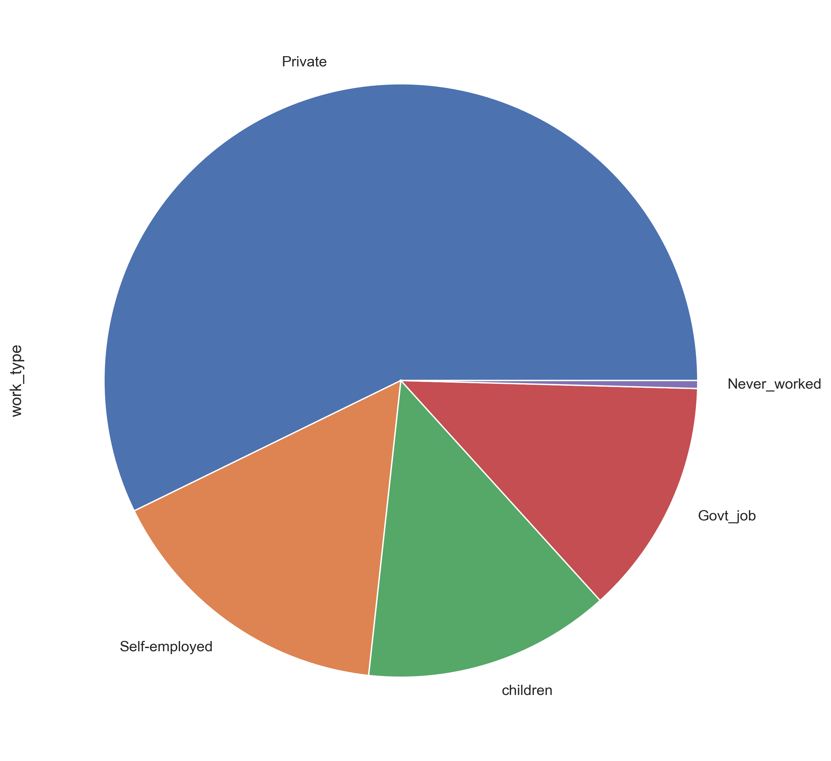
Work Type

Slide 14
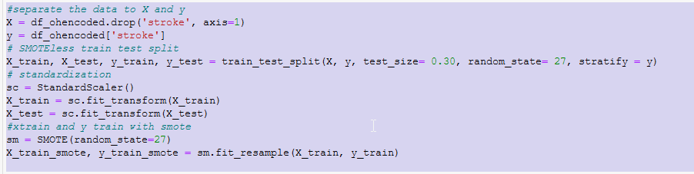
Setting up the Data
Separate
Train Test Split
Standardization
Smote
Recall: Focusing on Recall as the metric we want to improve. It is the measure of our model correctly identifying ‘True Positives’.
Recall = TP/(TP+ FN)

Slide 15
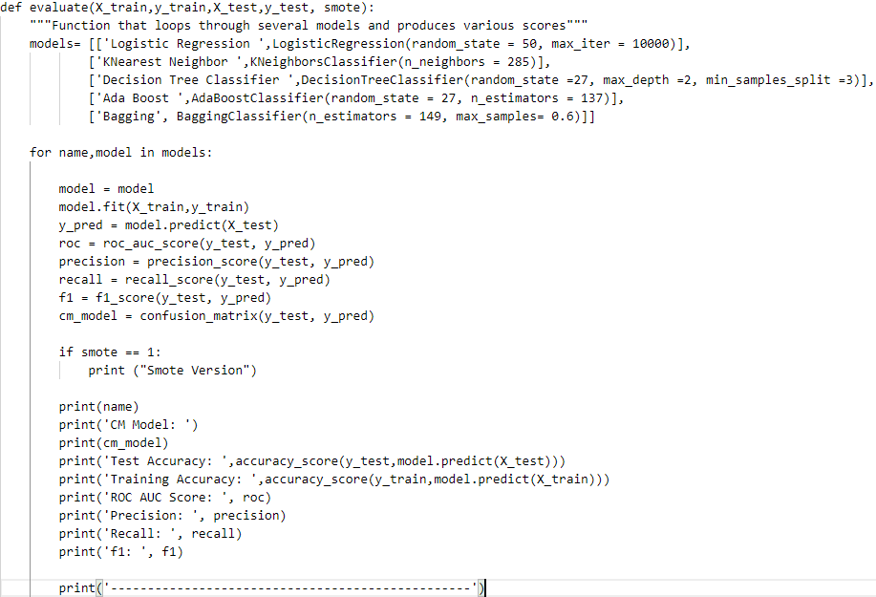

Slide 16


Running the function against our non-SMOTE data and our SMOTE data

Slide 17
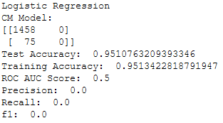
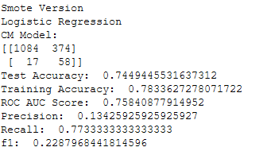
Logistic Regression
Non SMOTE
SMOTE
No predicted samples. Recall is 0

Slide 18
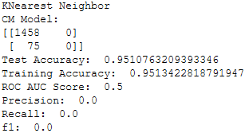
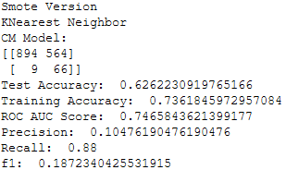
K Nearest Neighbor
Non SMOTE
SMOTE
No predicted samples. Recall is 0

Slide 19
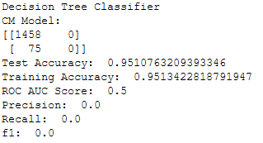
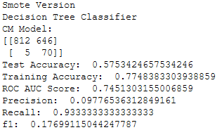
Decision Tree Classifier
Non SMOTE
SMOTE
No predicted samples. Recall is 0

Slide 20
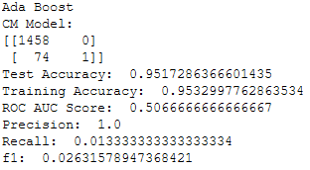
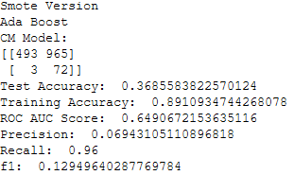
AdaBoost Classifier
Non SMOTE
SMOTE
Best Recall

Slide 21
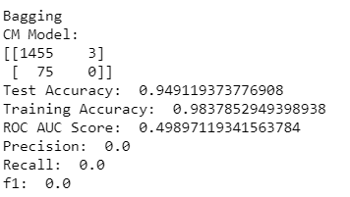
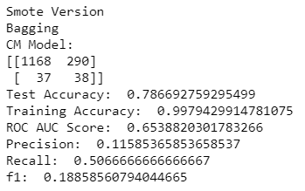
Bagging Classifier
Non SMOTE
SMOTE

Slide 22
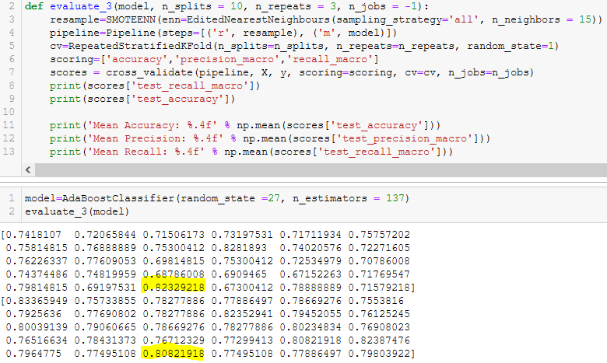
AdaBoost with SMOTEENN and RepeatedStratifiedKFold.
One of the folds achieved .8233 recall with .8082 accuracy.

Slide 23
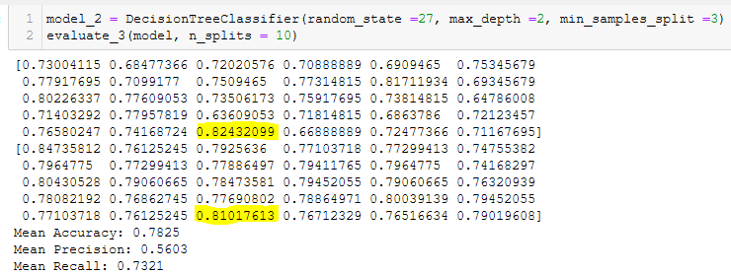
Using the same function as the previous slide, DecisionTreeClassifier with SMOTEENN and RepeatedStratifiedKFold.
One of the folds achieved .8243 recall with .8102 accuracy.

Slide 24
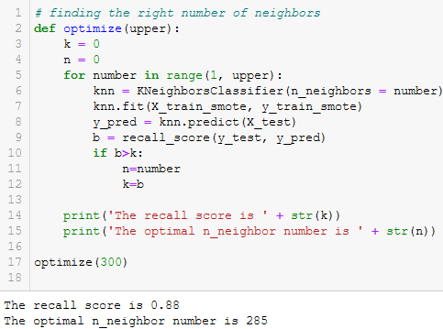
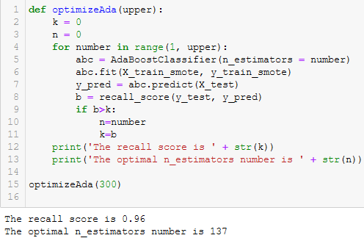
Tuning the models

Slide 25
Conclusion
Given the limitations of the datasets small minority group and the nature of the features available, we recommend the Logistic Regression model using SMOTE as the best model. It's generally good recall in addition to the balance between training accuracy and testing accuracy best fit our goals.

